Slide 1



PowerBI_End_Project
View in Power BI
Last data refresh:
03/03/2025 11:50:03 UTC
Downloaded at:
03/03/2025 11:59:10 UTC

Slide 2
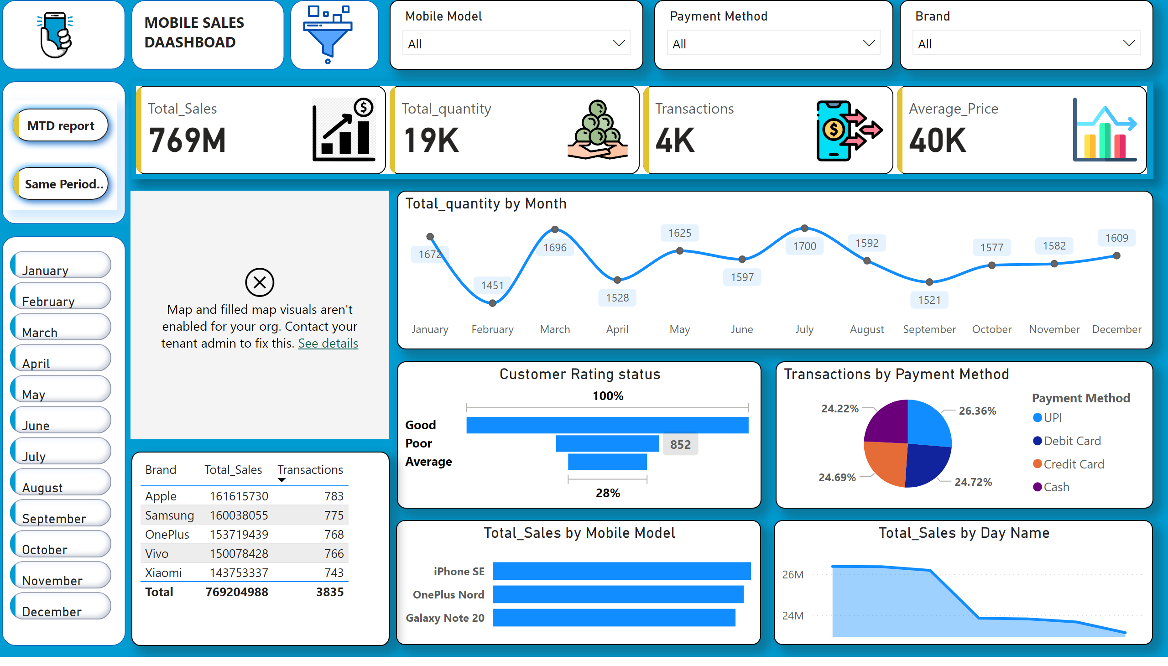
Dash Board
Notes:
image
No alt text provided
shape
No alt text provided
shape
No alt text provided
shape
No alt text provided
advancedSlicerVisual
No alt text provided
cardVisual
No alt text provided
slicer
No alt text provided
slicer
No alt text provided
slicer
No alt text provided
shape
No alt text provided
image
No alt text provided
shape
No alt text provided
textbox
No alt text provided
map
No alt text provided
lineChart
No alt text provided
Customer Rating status
No alt text provided
pieChart
No alt text provided
clusteredBarChart
No alt text provided
areaChart
No alt text provided
tableEx
No alt text provided
pageNavigator
No alt text provided

Slide 3
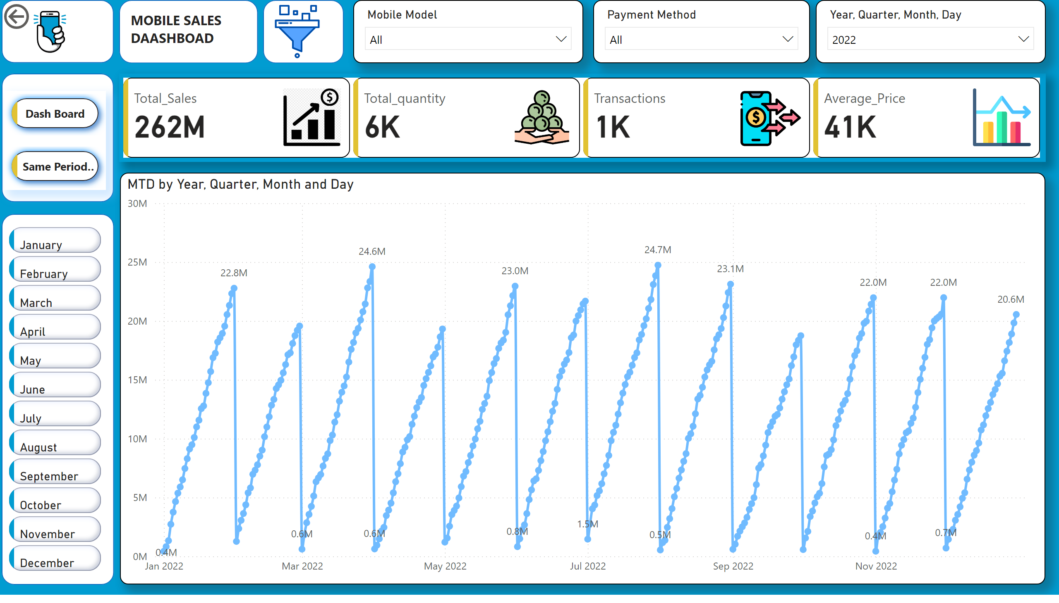
MTD report
Notes:
image
No alt text provided
shape
No alt text provided
shape
No alt text provided
cardVisual
No alt text provided
slicer
No alt text provided
slicer
No alt text provided
slicer
No alt text provided
shape
No alt text provided
image
No alt text provided
shape
No alt text provided
textbox
No alt text provided
lineChart
No alt text provided
actionButton
No alt text provided
shape
No alt text provided
advancedSlicerVisual
No alt text provided
pageNavigator
No alt text provided

Slide 4
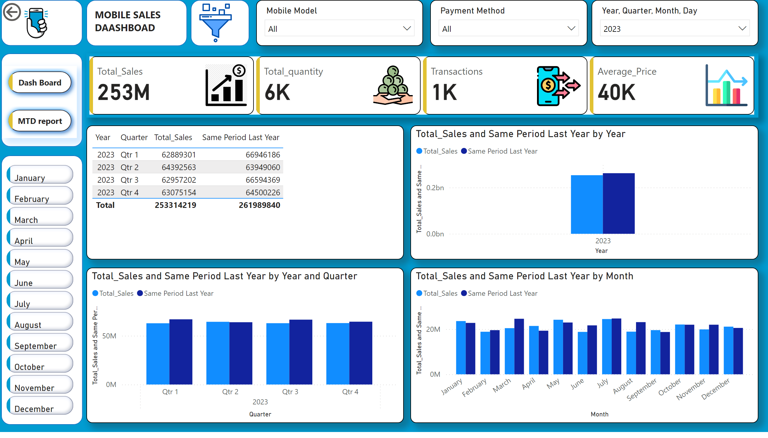
Same Period last year
Notes:
image
No alt text provided
shape
No alt text provided
shape
No alt text provided
cardVisual
No alt text provided
slicer
No alt text provided
slicer
No alt text provided
slicer
No alt text provided
shape
No alt text provided
image
No alt text provided
shape
No alt text provided
textbox
No alt text provided
actionButton
No alt text provided
shape
No alt text provided
advancedSlicerVisual
No alt text provided
tableEx
No alt text provided
clusteredColumnChart
No alt text provided
clusteredColumnChart
No alt text provided
clusteredColumnChart
No alt text provided
pageNavigator
No alt text provided

